Slide 1
William Stallings
Computer Organization and Architecture
6th Edition
Chapter 14
Instruction Level Parallelism
and Superscalar Processors

Slide 2
What is Superscalar?
Common instructions (arithmetic, load/store, conditional branch) can be initiated and executed independently
Equally applicable to RISC & CISC
In practice usually RISC

Slide 3
Why Superscalar?
Most operations are on scalar quantities (see RISC notes)
Improve these operations to get an overall improvement

Slide 4
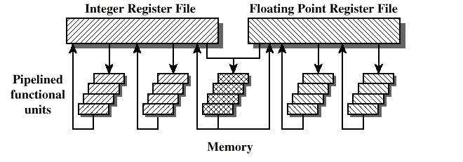
General Superscalar Organization

Slide 5
Superpipelined
Many pipeline stages need less than half a clock cycle
Double internal clock speed gets two tasks per external clock cycle
Superscalar allows parallel fetch execute

Slide 6
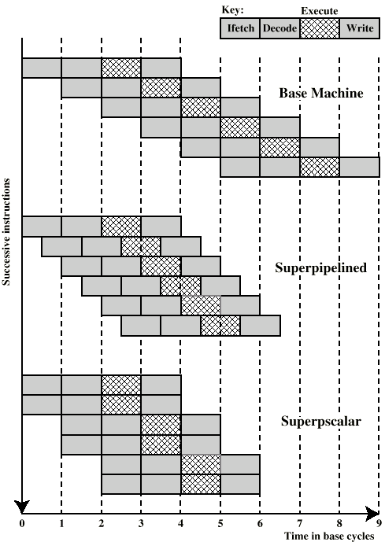
Superscalar v
Superpipeline

Slide 7
Limitations
Instruction level parallelism
Compiler based optimisation
Hardware techniques
Limited by
  True data dependency
  Procedural dependency
  Resource conflicts
  Output dependency
  Antidependency

Slide 8
True Data Dependency
ADD r1, r2 (r1 := r1+r2;)
MOVE r3,r1 (r3 := r1;)
Can fetch and decode second instruction in parallel with first
Can NOT execute second instruction until first is finished

Slide 9
Procedural Dependency
Can not execute instructions after a branch in parallel with instructions before a branch
Also, if instruction length is not fixed, instructions have to be decoded to find out how many fetches are needed
This prevents simultaneous fetches

Slide 10
Resource Conflict
Two or more instructions requiring access to the same resource at the same time
  e.g. two arithmetic instructions
Can duplicate resources
  e.g. have two arithmetic units

Slide 11
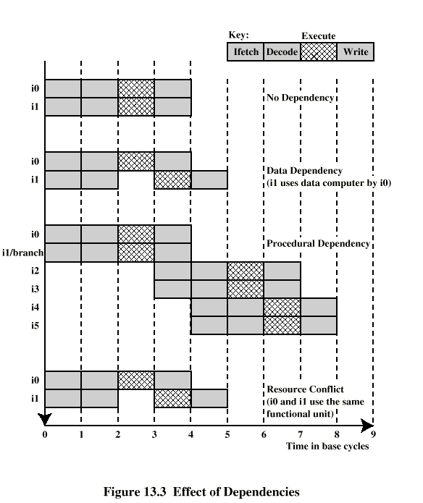
Effect of
Dependencies

Slide 12
Design Issues
Instruction level parallelism
  Instructions in a sequence are independent
  Execution can be overlapped
  Governed by data and procedural dependency
Machine Parallelism
  Ability to take advantage of instruction level parallelism
  Governed by number of parallel pipelines

Slide 13
Instruction Issue Policy
Order in which instructions are fetched
Order in which instructions are executed
Order in which instructions change registers and memory

Slide 14
In-Order Issue
In-Order Completion
Issue instructions in the order they occur
Not very efficient
May fetch >1 instruction
Instructions must stall if necessary

Slide 15
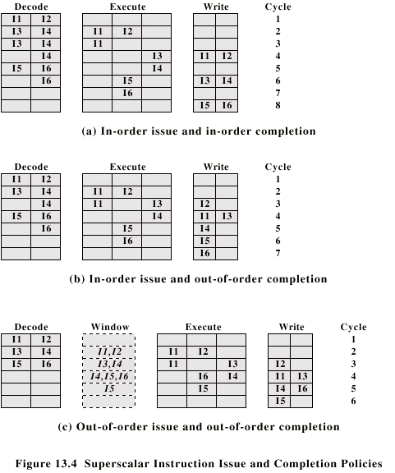
In-Order Issue In-Order Completion (Diagram)

Slide 16
In-Order Issue
Out-of-Order Completion
Output dependency
  R3:= R3 + R5; (I1)
  R4:= R3 + 1; (I2)
  R3:= R5 + 1; (I3)
  I2 depends on result of I1 - data dependency
  If I3 completes before I1, the result from I1 will be wrong - output (read-write) dependency

Slide 17
In-Order Issue Out-of-Order Completion (Diagram)

Slide 18
Out-of-Order Issue
Out-of-Order Completion
Decouple decode pipeline from execution pipeline
Can continue to fetch and decode until this pipeline is full
When a functional unit becomes available an instruction can be executed
Since instructions have been decoded, processor can look ahead

Slide 19
Out-of-Order Issue Out-of-Order Completion (Diagram)

Slide 20
Antidependency
Write-write dependency
  R3:=R3 + R5; (I1)
  R4:=R3 + 1; (I2)
  R3:=R5 + 1; (I3)
  R7:=R3 + R4; (I4)
  I3 can not complete before I2 starts as I2 needs a value in R3 and I3 changes R3

Slide 21
Register Renaming
Output and antidependencies occur because register contents may not reflect the correct ordering from the program
May result in a pipeline stall
Registers allocated dynamically
  i.e. registers are not specifically named

Slide 22
Register Renaming example
R3b:=R3a + R5a (I1)
R4b:=R3b + 1 (I2)
R3c:=R5a + 1 (I3)
R7b:=R3c + R4b (I4)
Without subscript refers to logical register in instruction
With subscript is hardware register allocated
Note R3a R3b R3c

Slide 23
Machine Parallelism
Duplication of Resources
Out of order issue
Renaming
Not worth duplication functions without register renaming
Need instruction window large enough (more than 8)

Slide 24
Branch Prediction
80486 fetches both next sequential instruction after branch and branch target instruction
Gives two cycle delay if branch taken

Slide 25
RISC - Delayed Branch
Calculate result of branch before unusable instructions pre-fetched
Always execute single instruction immediately following branch
Keeps pipeline full while fetching new instruction stream
Not as good for superscalar
  Multiple instructions need to execute in delay slot
  Instruction dependence problems
Revert to branch prediction

Slide 26
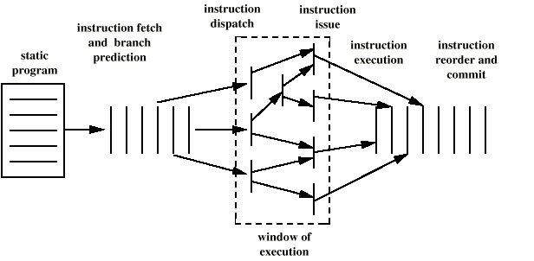
Superscalar Execution

Slide 27
Superscalar Implementation
Simultaneously fetch multiple instructions
Logic to determine true dependencies involving register values
Mechanisms to communicate these values
Mechanisms to initiate multiple instructions in parallel
Resources for parallel execution of multiple instructions
Mechanisms for committing process state in correct order

Slide 28
Pentium 4
80486 - CISC
Pentium – some superscalar components
  Two separate integer execution units
Pentium Pro – Full blown superscalar
Subsequent models refine & enhance superscalar design

Slide 29
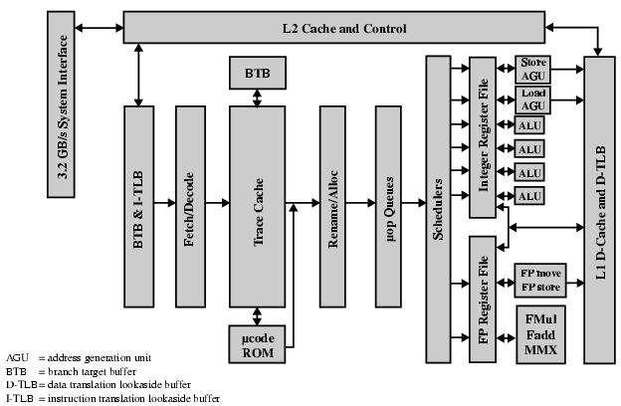
Pentium 4 Block Diagram

Slide 30
Pentium 4 Operation
Fetch instructions form memory in order of static program
Translate instruction into one or more fixed length RISC instructions (micro-operations)
Execute micro-ops on superscalar pipeline
  micro-ops may be executed out of order
Commit results of micro-ops to register set in original program flow order
Outer CISC shell with inner RISC core
Inner RISC core pipeline at least 20 stages
  Some micro-ops require multiple execution stages
    Longer pipeline
  c.f. five stage pipeline on x86 up to Pentium

Slide 31
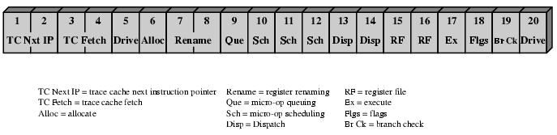
Pentium 4 Pipeline

Slide 32
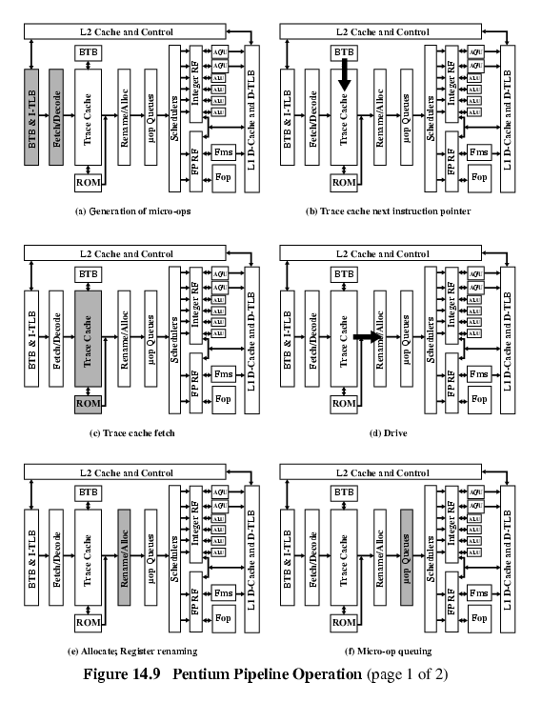
Pentium 4 Pipeline Operation (1)

Slide 33
Pentium 4 Pipeline Operation (2)

Slide 34
Pentium 4 Pipeline Operation (3)

Slide 35
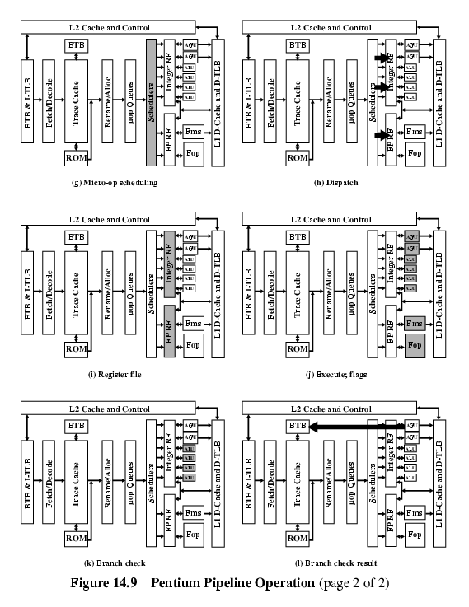
Pentium 4 Pipeline Operation (4)

Slide 36
Pentium 4 Pipeline Operation (5)

Slide 37
Pentium 4 Pipeline Operation (6)

Slide 38
PowerPC
Direct descendent of IBM 801, RT PC and RS/6000
All are RISC
RS/6000 first superscalar
PowerPC 601 superscalar design similar to RS/6000
Later versions extend superscalar concept

Slide 39
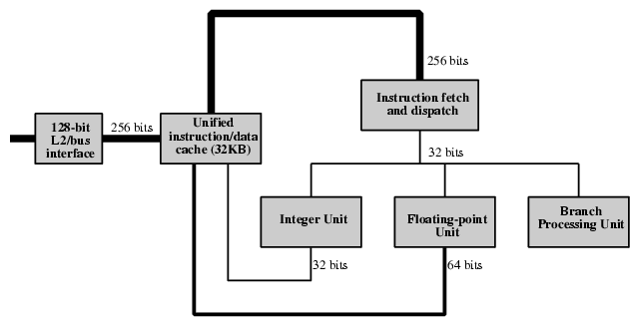
PowerPC 601 General View

Slide 40
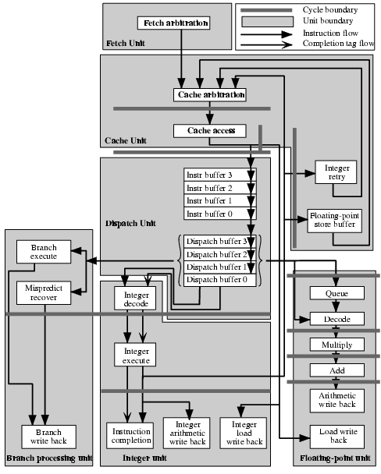
PowerPC 601
Pipeline
Structure

Slide 41
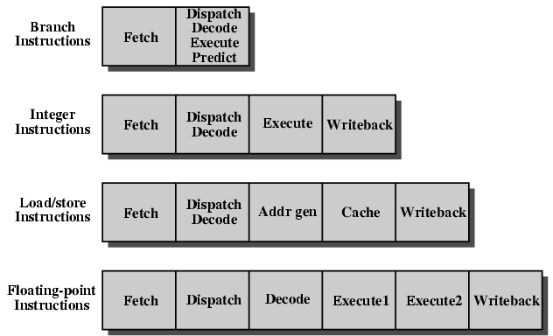
PowerPC 601 Pipeline

Slide 42
Required Reading
Stallings chapter 14
Manufacturers web sites
IMPACT web site
  research on predicated execution

